Slide 1
Team alpha
Phuong Le
Sumera Usmani
Shaun Nasiri

Slide 2


What Is It?
Information Security Themed Site
- Collaboration
- Industry best practices
- Calendar to display local group meetups

Slide 3

Why It’s Needed?

Slide 4
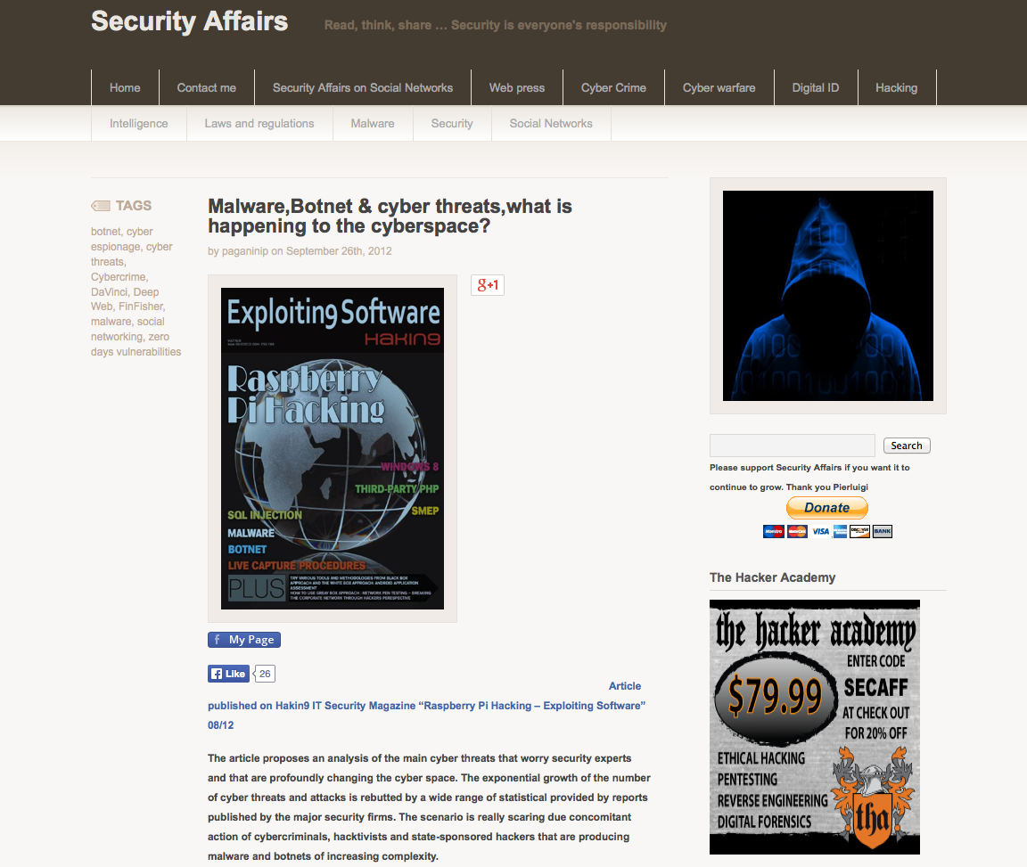
Related Projects
securityaffairs.co

Slide 5

Target Market
Private Companies
InfoSec Professionals
Home User
Govt. Orgs
Non-Profit Orgs

Slide 6
Summary
Information Security Themed Site
Collaboration
Latest Security-Related News
Foster Social Interactions amongst Professionals
Deliver community proven processes and guidance
Provide links to special publications
Build network of Security-Minded Professionals

